Slide 1
Clean Code
Sharing Knowledge
Trainee: Le Hung Phong
Nguyen Van Thuan

Slide 2
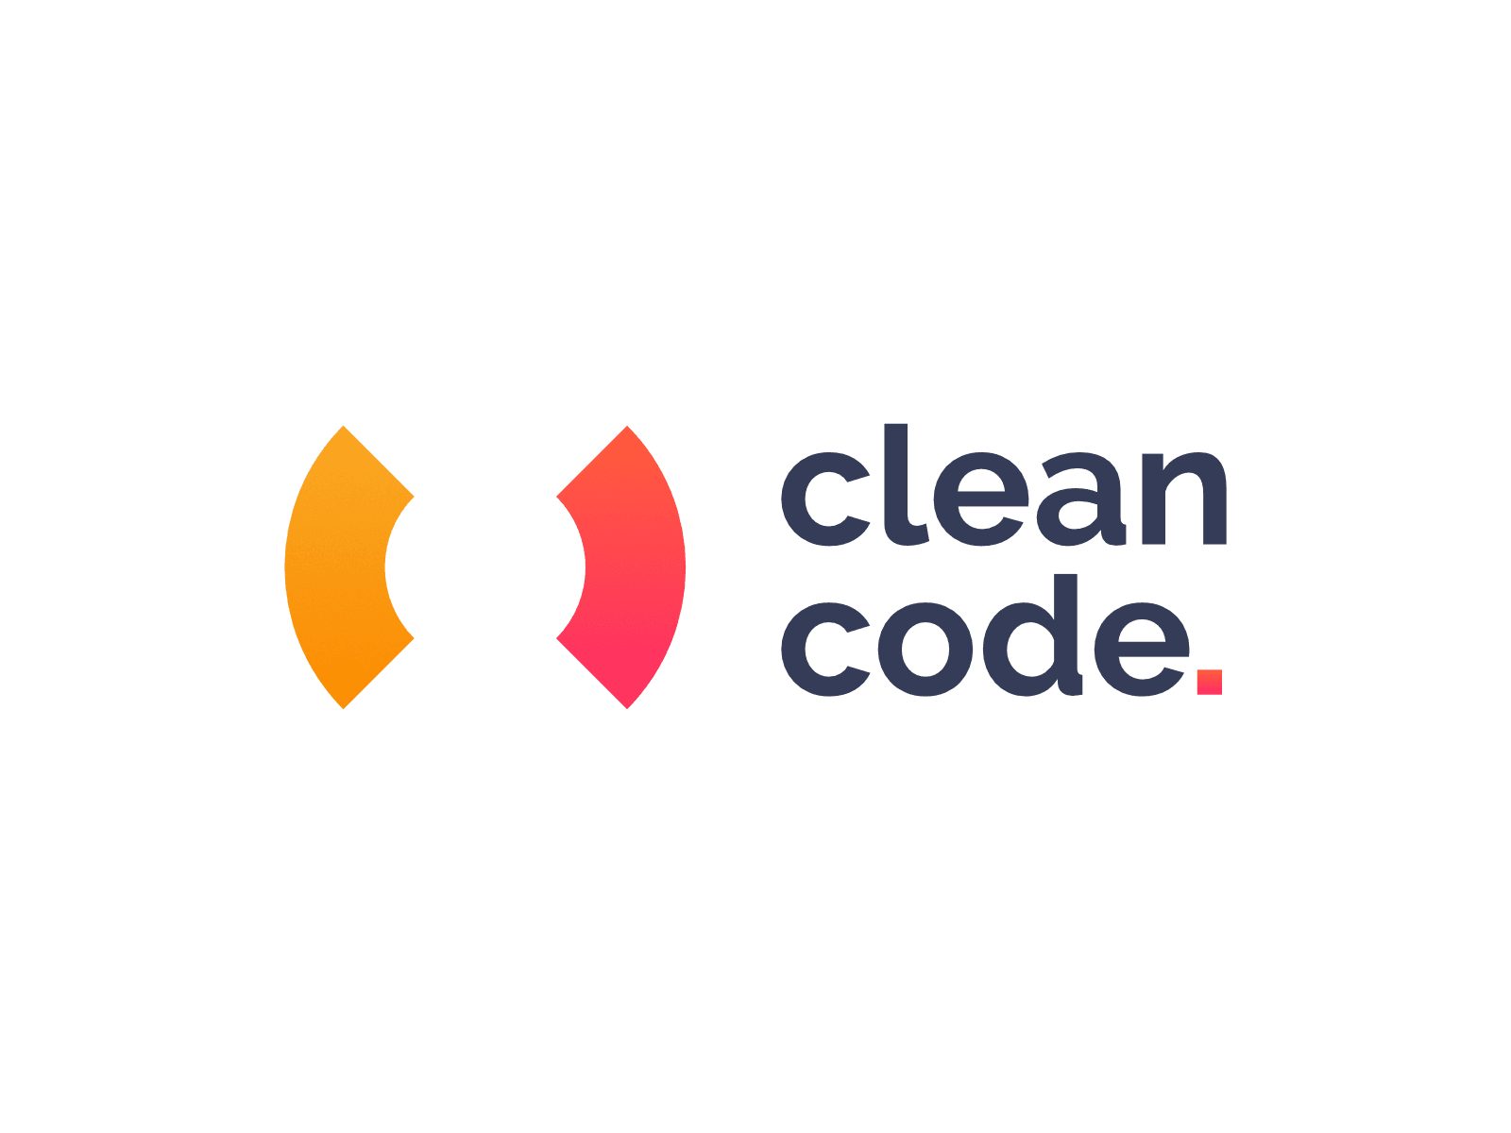
Overview
Clean Code
Code Convention
Code Reuse
Refactor Code

Slide 3
Clean Code

Slide 4
Clean Code
What is clean code?
Benefits of clean code.

Slide 5
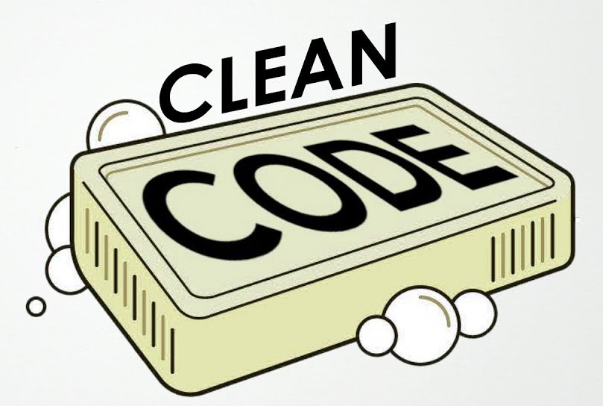
1.1 What is clean code?
Clean code is code that is easy to understand and easy to change

Slide 6
Easy to Understand
1. It is easy to understand the execution flow of the entire application
2. It is easy to understand how the different objects collaborate with each other
3. It is easy to understand the role and responsibility of each class
4. It is easy to understand what each method does
5. It is easy to understand what is the purpose of each expression and variable

Slide 7
Easy to Change
Classes and methods are small and only have single responsibility
Classes have clear
Classes and methods are predictable and work as expected
The code is easily testable and has unit tests (or it is easy to write the tests)
Tests are easy to understand and easy to change

Slide 8
1.2 Benefits of Clean Code
Easy to read and develop
Easy to maintenance or scale
“Clean code” helps everyone form a common rule
“Clean code” shows the professionalism of the development team

Slide 9
2. Code Convention

Slide 10
2. Code Convention
What is Code Convention?
Examples of Code Convention

Slide 11
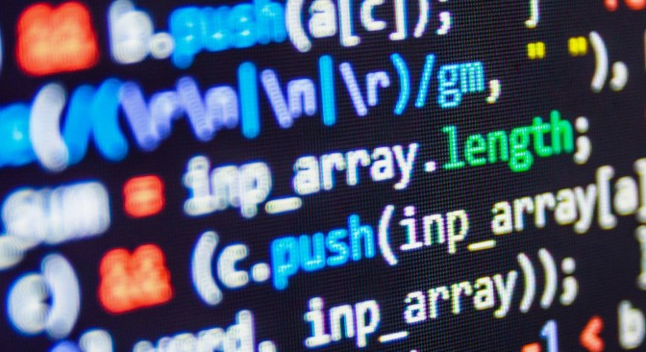
2.1 What is Code Convention?
Code Convention is a collection of style guides for a programming language. Code Conventions can be rules set forth by companies, groups or individuals

Slide 12
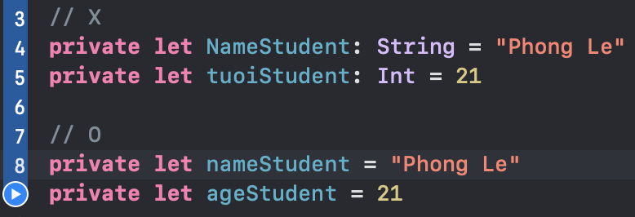
2.2 Examples (naming)

Slide 13
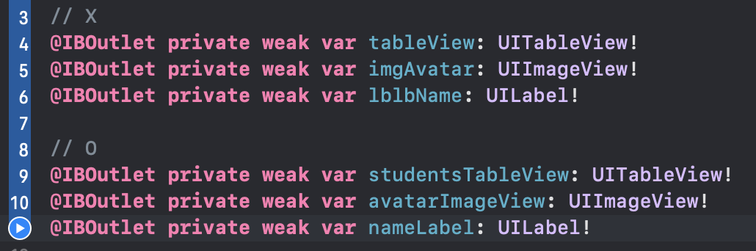
2.2 Examples (naming)

Slide 14
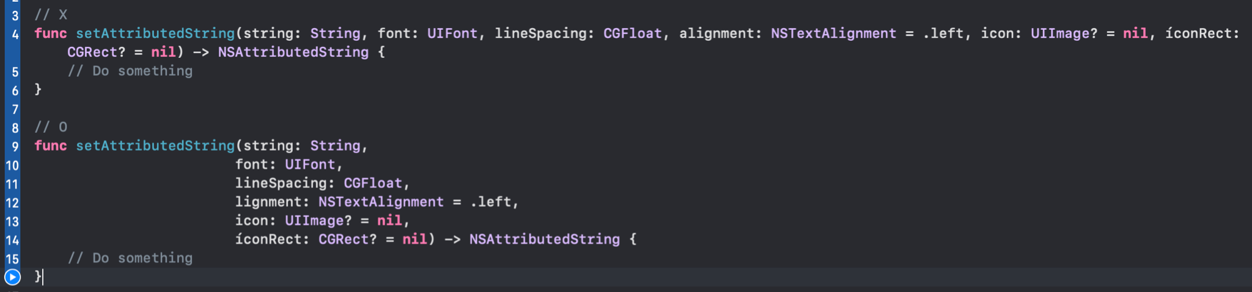
2.2 Examples (organize function)

Slide 15
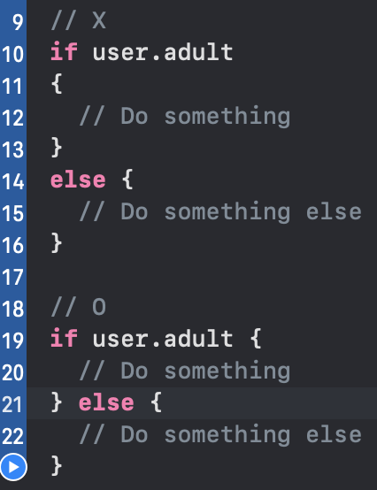
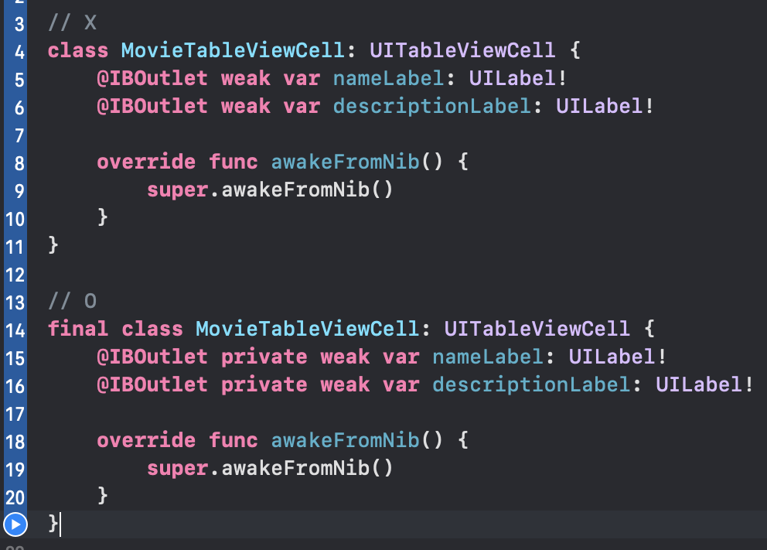
2.2 Examples (spacing & access control)

Slide 16
3. Code Reuse

Slide 17
3. Code Reuse
What Is Code Reuse?
Benefits and Risks of Code Reuse
When Is Code Reuse Possible?
Code Reuse and Technical Challenges

Slide 18
3.1 What is Code Reuse?
Code reuse is the practice of using existing code for a new function or software

Slide 19
3.2 Benefits and Risks of Code Reuse
Shorter development time
Better end product
Benefits

Slide 20
3.2 Benefits and Risks of Code Reuse
Conflict
Impact can be exponential
Attackers are quick, lost control
Risks

Slide 21
3.3 When Is Code Reuse Possible?
Easily extended and adapted for the new application.
Ported to different hardware if needed.
Exist code are reliability, safety, or security of the new application.

Slide 22
4. Refactor Code

Slide 23
4. Refactor Code
What is Refactor Code?
When should we Refactor Code?
Examples of Refactor Code

Slide 24

4.1 What is Refactor Code?
Refactor Code is to change the internal structure without changing the external behavior of the system

Slide 25
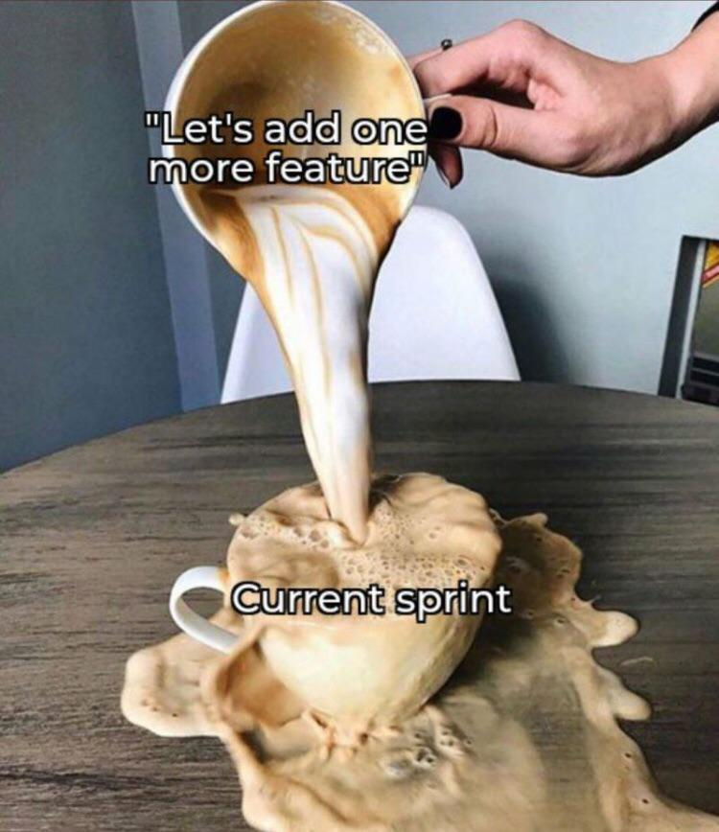
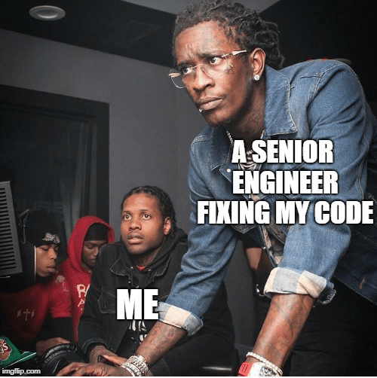
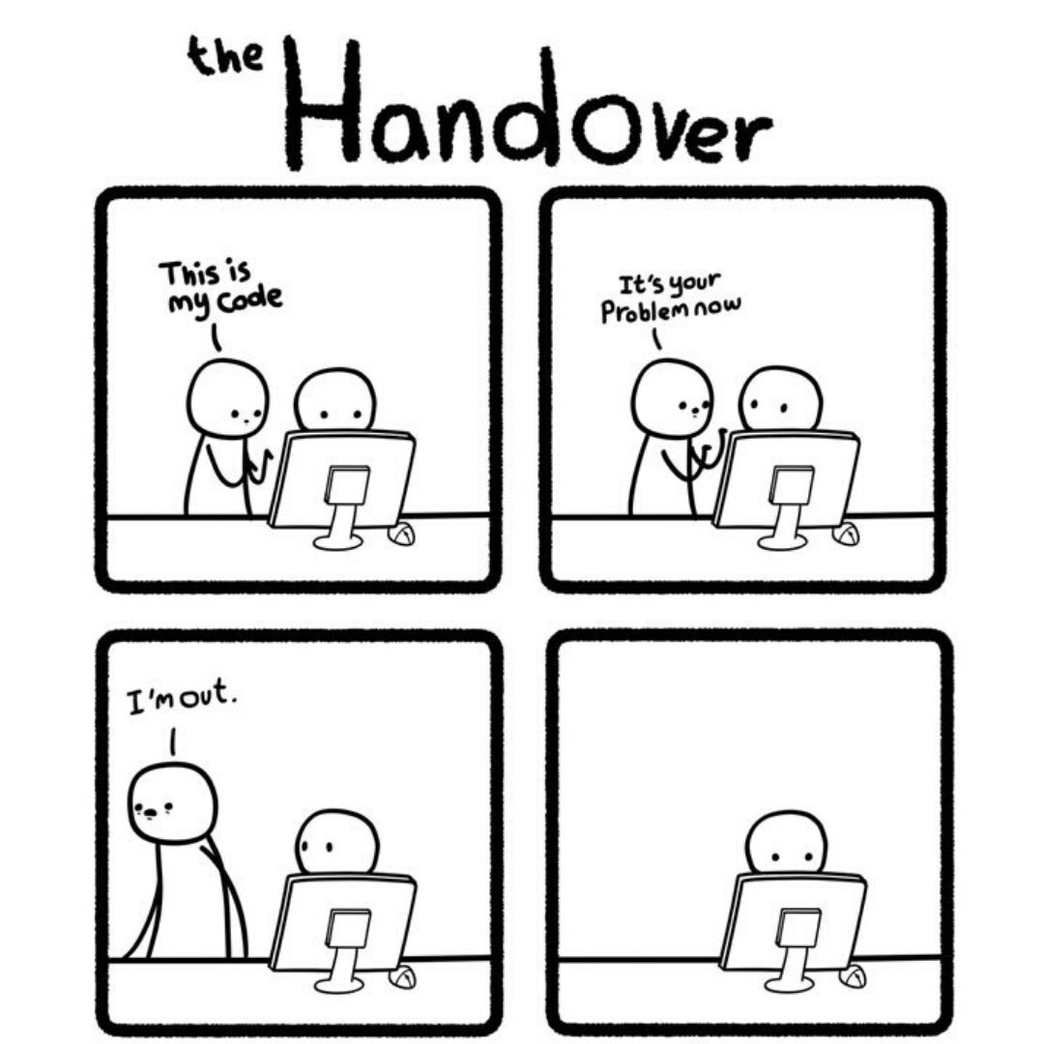
4.2 When should we Refactor Code?

Slide 26
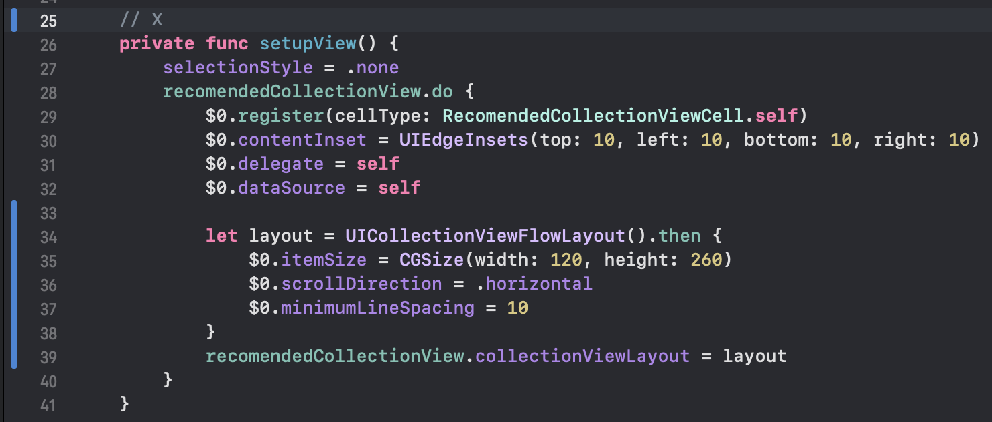
4.3 Examples

Slide 27
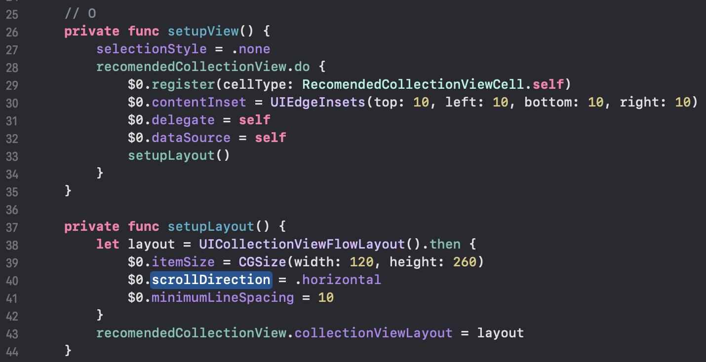
4.3 Examples (cont)

Slide 28
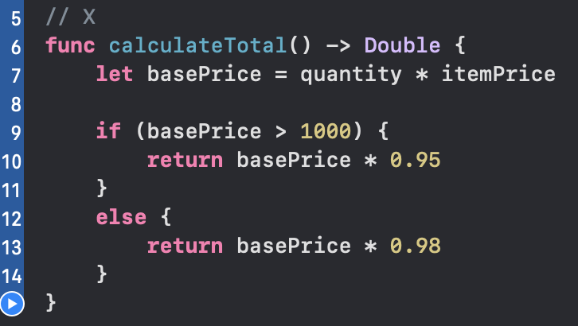
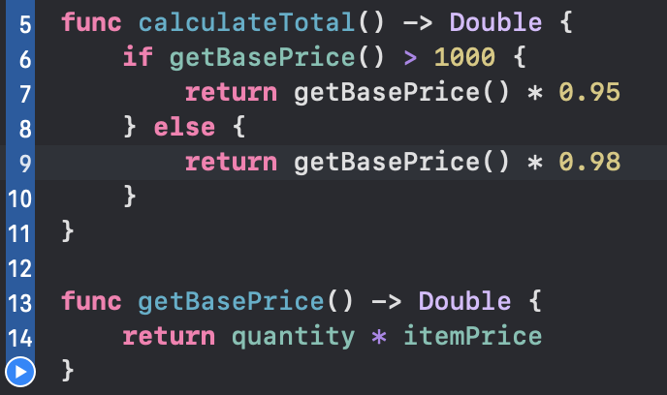
4.3 Examples (cont)

Slide 29
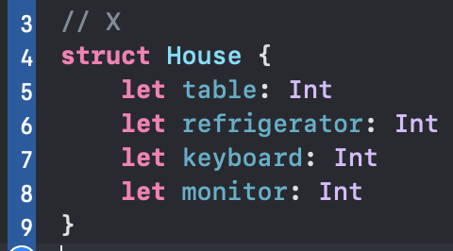
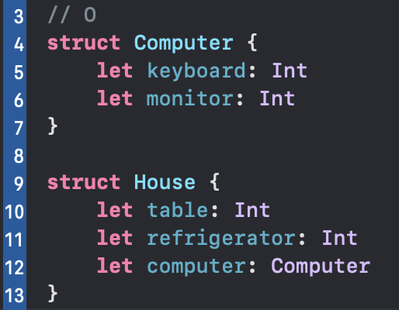
4.3 Examples (cont)

Slide 30
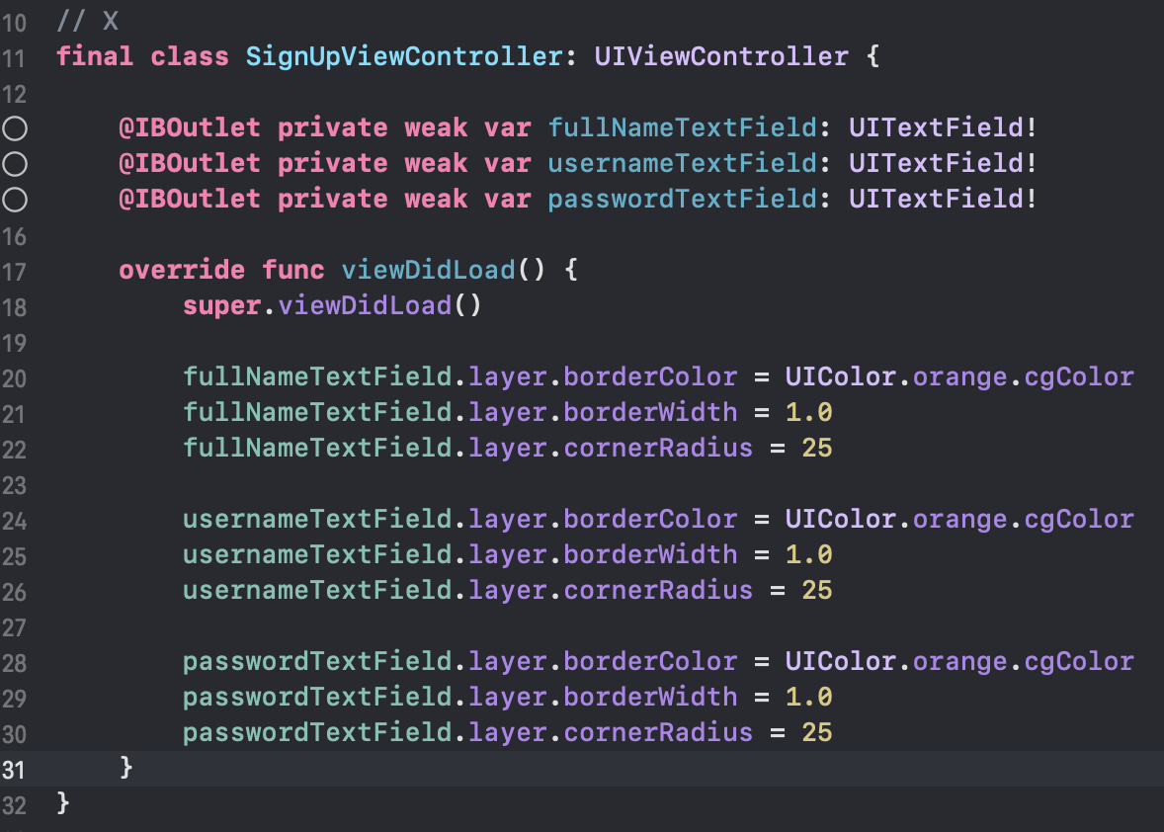
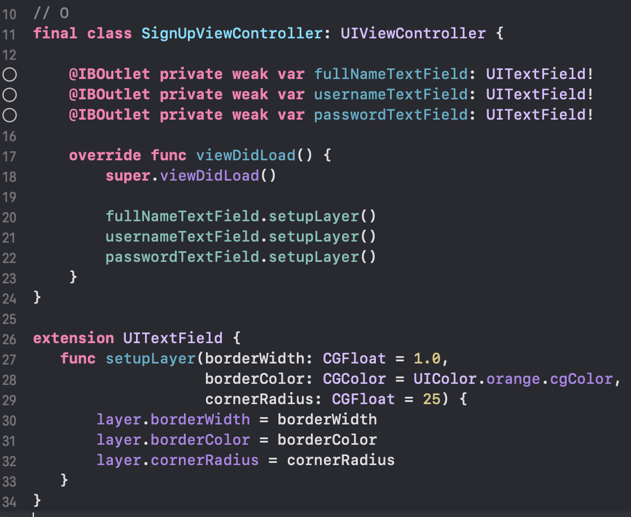
4.3 Examples (cont)

Slide 31
Conclusion
What is clean code? Benefits of clean code
How to apply code convention in project
What is code reuse and how to reuse code
What is refactor code and how to refactor code

Slide 32
THANK YOU!

